Slide 1
Business Across the Enterprise

Slide 2
Introduction: Business Across the Enterprise
Traditional departments worked in silos – limited collaboration.
Modern businesses require cross-functional integration.
Enterprise systems enable data sharing and real-time visibility.
Three major systems: CRM, ERP, SCM.
Example: Apple integrates all three for global efficiency.

Slide 3
Business Across the Enterprise
Integrating all major business functions across the entire organization.
These systems:
Facilitate data sharing across departments.
Provide real-time visibility of operations.
Support strategic decision-making.
Enable collaboration with customers, suppliers, and partners.

Slide 4
Customer Relationship Management (CRM)
CRM manages customer interactions and relationships.
Goal: increase satisfaction, loyalty, and profitability.
Types: Operational, Analytical, Collaborative CRM.
Supports sales, marketing, and customer service.

Slide 5
Objectives of CRM
Build long-term customer relationships.
Increase customer satisfaction and loyalty.
Improve communication and responsiveness.
Enable personalized products and services.
Enhance profitability by focusing on high-value customers.

Slide 6
CRM Components & Benefits
Operational CRM
Automates customer-facing processes such as sales, marketing, and service.
Example: Salesforce automates follow-ups and tracks customer interactions.
Includes:
Sales force automation (SFA)
Marketing automation
Customer service management

Slide 7
Analytical CRM
Focuses on data analysis and insights to understand customer behavior.
Uses tools like data mining, predictive analytics, and dashboards.
Example: Predicting which customers are likely to churn or buy again.

Slide 8
Collaborative CRM
Enables communication between the company and its external stakeholders (partners, distributors, customers).
Example: Shared portals for customer feedback and product updates.

Slide 9
CRM Life Cycle
Customer Acquisition – attract potential customers through marketing campaigns.
Customer Retention – keep customers satisfied through personalized service.
Customer Extension – sell new or upgraded products to existing customers.

Slide 10
CRM Technologies
Customer Databases – store profiles, transactions, and preferences.
Call Center Systems – manage support requests.
Web Portals & Chatbots – provide self-service options.
Mobile CRM – access CRM data through smartphones/tablets.
Social CRM – analyze interactions from social media channels.

Slide 11
Benefits
Improved customer service & responsiveness.
Enhanced marketing effectiveness through segmentation.
Increased cross-selling and up-selling.
Greater customer loyalty and retention.
Better data-driven decision-making.

Slide 12
Challenges
Data integration across multiple channels.
High implementation cost.
User adoption and training.
Privacy and data protection issues.

Slide 13
Enterprise Resource Planning (ERP)
ERP systems are integrated management software that unify all core business processes into a single centralized system.
They provide one shared database that supports multiple business functions across departments.
Core modules: Finance, HR, Production, Sales, Inventory.

Slide 14
Key Characteristics
Integration: All modules share a single source of data.
Automation: Reduces manual entry and duplication.
Standardization: Ensures consistency across global operations.
Scalability: Adapts as the organization grows.

Slide 15
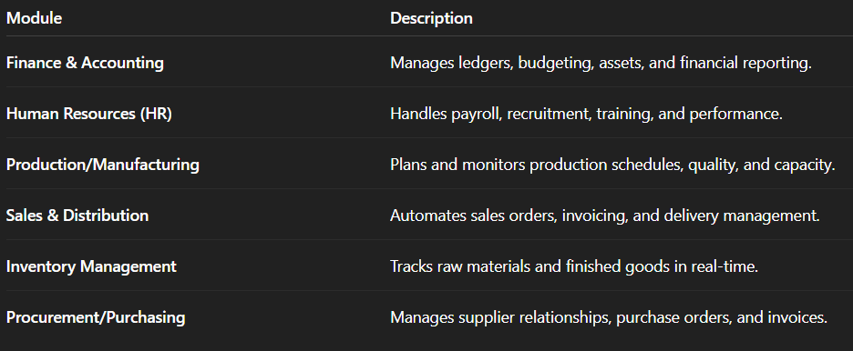
Core ERP Modules

Slide 16
ERP Workflow Example
A sales order is entered (Sales module).
The system checks inventory (Inventory module).
If materials are low, it triggers a purchase order (Procurement).
Finance updates accounts payable and receivable automatically.

Slide 17
ERP Vendors
SAP ERP – global leader with modular design.
Oracle ERP Cloud – integrated cloud-based solution.
Microsoft Dynamics 365 – mid-size business solution.
Infor, Workday, Netsuite – industry-specific ERPs.

Slide 18
ERP Benefits & Challenges
Benefits:
Streamlined operations and accurate data.
Better reporting and scalability.
Reduces redundancy and cost.
Challenges:
High cost and complexity.
Requires process reengineering.
Change resistance from staff.

Slide 19
ERP Example: Nestlé Case
Before: Over 200 legacy systems globally.
After ERP (SAP): unified system for finance & procurement.
Result: Standardized processes, faster reporting, cost savings.

Slide 20
Supply Chain Management (SCM)
Manages end-to-end flow of goods and information.
Stages: Planning, Sourcing, Making, Delivering, Returning.
Components: Procurement, Inventory, Logistics, Forecasting.
Goal: Optimize cost, speed, and supplier coordination.

Slide 21
Objectives
Ensure products are available when and where needed.
Reduce costs and waste.
Enhance supplier collaboration. Improve customer satisfaction and delivery performance.

Slide 22
SCM Process Stages
Planning: Forecast demand, plan production, and set inventory levels.
Sourcing: Select and manage suppliers.
Making: Schedule production and manage operations.
Delivering: Manage warehousing, logistics, and transport.
Returning: Handle customer returns and defective goods.

Slide 23
Major SCM Components
Procurement Management – supplier evaluation, contract management.
Inventory Control – maintaining optimal stock levels.
Logistics Management – transportation and warehouse coordination.
Demand Forecasting – predicting customer demand using analytics.
Supplier Relationship Management – collaboration and performance evaluation.

Slide 24
SCM Technologies & Example
Technologies:
RFID, IoT, Blockchain, AI-based forecasting.
EDI for automated document exchange.
Example:
Walmart: real-time inventory tracking, automatic restocking.

Slide 25
Integration: CRM + ERP + SCM
Integration ensures seamless data flow across all systems.
CRM: captures order → ERP: plans production → SCM: manages delivery.
Benefits: Efficiency, accuracy, collaboration, faster response.
Example: Dell’s build-to-order model integrates all systems.

Slide 26
Class Activity: TechNest Simulation
Scenario:
Online smart device company.
Task:
Map how CRM, ERP, SCM interact for an order.
Identify data flow and integration challenges.
Outcome:
Understand enterprise-wide data coordination.

Slide 27
Lecture Summary
CRM – Customer-facing, improves satisfaction.
ERP – Internal operations, enhances efficiency.
SCM – Supplier-customer coordination, reduces cost.
Integrated systems drive total business efficiency.

